Slide 1
Digital portfolio

Slide 2
STUDENT DETAILS
Student name :Navya. A. P
Registration number :212400426
NMID:9D8BD70B5F1A7A59ACA45B34FECD2076
Department :Computer Application
College:Sindhi College

Slide 3
Next gen resume
Interactive digital portfolio using front end development

Slide 4
AGENDA
Problem Statement
Project Overview
End Users
Tools and Technologies
Portfolio design and Layout
Features and Functionality
Results and Screenshots
Conclusion
Github Link

Slide 5
PROBLEM STATEMENT
In today’s competitive world, individuals need a professional platform to showcase their skills, projects, and achievements. A physical resume alone is not enough, as recruiters and institutions prefer interactive digital and visually appealing portfolios. Therefore, there is a need to create a digital portfolio that highlights personal and professional growth in a structured way.

Slide 6
PROJECT OVERVIEW
The project focus on creating a personal digital portfolio that highlights education, skills, projects and achievements. It provides a professional and interactive platform to present one’s profile, making it more impactful than a traditional resume.

Slide 7
WHO ARE THE USERS?
Students(academic projects, resumes)
Job seekers(to share With recruiters)
Freelancer(to show clients)
Professionals(to highlight experience and achievements )

Slide 8
TOOLS AND TECHNOLOGIES
HTML➖Structures (pages, sections)
CSS➖Styling(colors, layouts, responsiveness)
JavaScript➖Interactivity(Navigation menu, animations, form validations)
CODEPEN and hosting platform(GitHub Pages)

Slide 9
PORTFOLIO DESIGN AND LAYOUT
Section included:
Home/about me
Projects
Skills
Contact
Responsive layout (Mobile+desktop view)

Slide 10
FEATURES AND FUNCTIONALITY
Navigation bar with smooth scrolling.
Project showcase with images/details.
Interactive elements(hover effects, animation).
Contact form(With validation).
Responsive design for all devices.

Slide 11
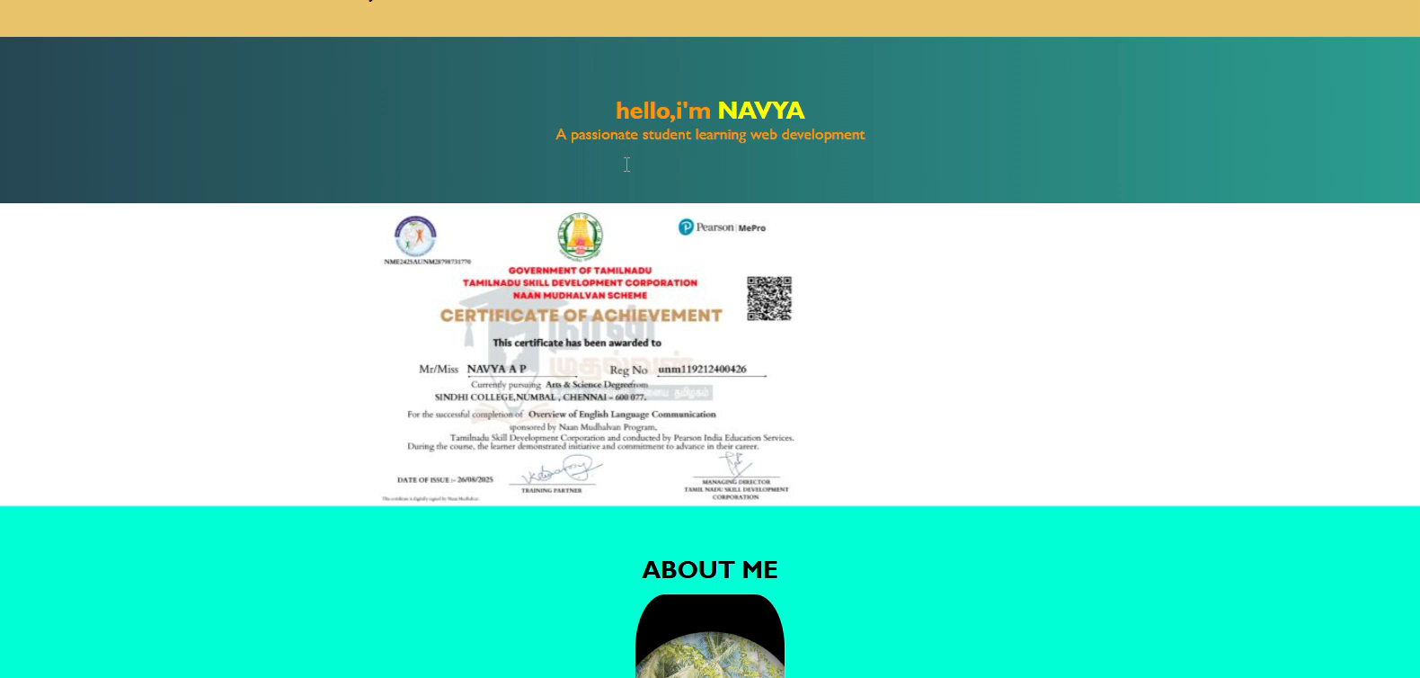
RESULTS AND SCREENSHOTS

Slide 12
CONCLUSION
The digital portfolio serves as a modern and professional way to present academic and professional achievements. It is more interactive and visually appealing then traditional resume. This portfolio will help in personal branding, improve chances of selection during interviews and act as a long-term record of growth and accomplishment

